Slide 1

Predicting housing prices in Ames , Iowa
Vaishnavi Brungi

Slide 2
Problem Statement
At our real estate investment firm, apart from providing investors with new and refurbished investment properties, we also do consultation service to sellers who want to sell their homes by estimating sale price, finding buyers, taking care of the documentation process until seller handovers key to the buyer.
We have been given list of clients who are willing to sell their homes in Ames city in Iowa.
This analysis seeks to predict sale price of homes in Ames.
This analysis also aims to list down top factors that affect sale price in Ames which can be used as a checklist in the future if any client from these locations approaches us seeking consultation service to sell their property.

Slide 3
Understanding the data
81 Features
Nominal(24)
Sale Type
Garage Type
Building Type
Street
MS Zoning
Heating
Central Air
Misc Feature
Etc.
Continuous(21)
Lot Frontage
Lot Area
1st Floor Sq Ft
Sale Price
Garage Area
Total Basement Sq Ft
2nd Floor Sq Ft
Pool Area
Etc.
Discrete(15)
Year Built
Full Bath
Half Bath
Fireplaces
Year Sold
Month Sold
Garage Cars
Year Remod/Add
Etc.
Ordinal(23)
Lot Shape
Garage Condition
Overall Quality
Basement Quality
Kitchen Quality
Fireplace Quality
Utilities
Lot Shape
Etc..

Slide 4
Data Cleaning
Examining Null values
Converting column names to lower case
Replacing ‘underscore’ instead of space between column names
Renaming the columns
Changing Datatype from ‘float’ to ‘int’

Slide 5
Feature Engineering
Total Basement Sq ft
1.Bsmt Fin SF 1
2.Bsmt Fin SF 2
3.Bsmt Unf SF
bathrooms
1.Bsmt Full Bath
2.Bsmt Half Bath
3.Full Bath
4.Half Bath
has pool
Pool Qc :
Ex,Gd,TA,Fa=1
NA=0
paved street
gravel = 0
paved = 1
has garage
Fin , RFn , Unf =1
NA=0
Above ground living area sq ft
1.Low Qual Fin SF
2.1st Flr SF
3.2nd Flr SF
has fence
Fence :
GdPrv, MnPrv, GdWo, MnWw=1
NA=0
has central air
N =0
Y=1
Is remodeled
Year remod/add-year built

Slide 6
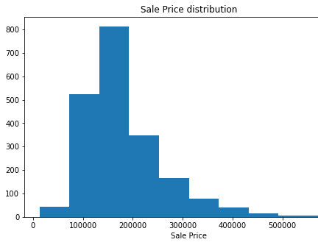
Right skewed distribution
Outliers beyond 500000

Slide 7
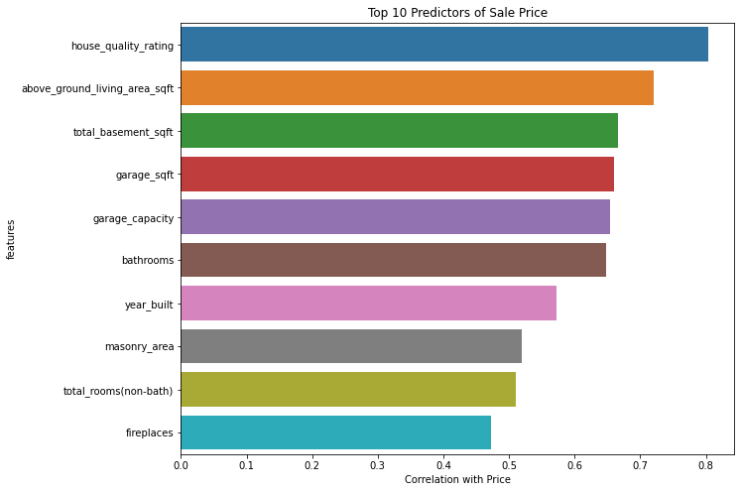
Correlations with Sale Price :
House Quality Rating
Above Ground Living Area Sq Ft
Total Basement Sq Ft
Garage Sq Ft
Garage Capacity
Bathrooms
Year Built
Masonry Area
Total Rooms(Non-bath)
Fireplaces
Outliers were removed for :
Total basement sq ft
Bathrooms
Masonry area
Garage capacity

Slide 8
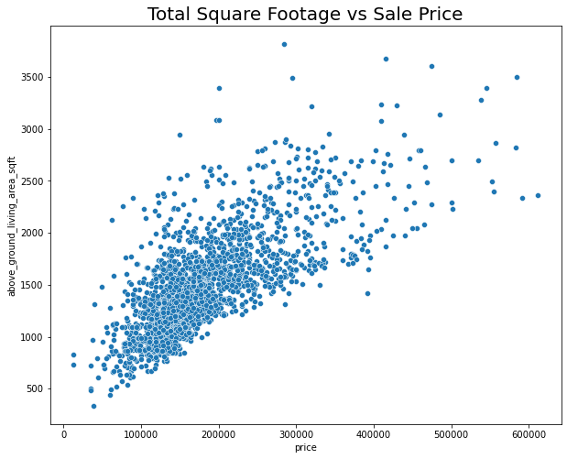
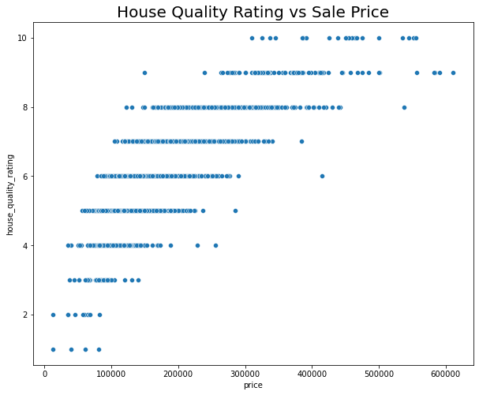
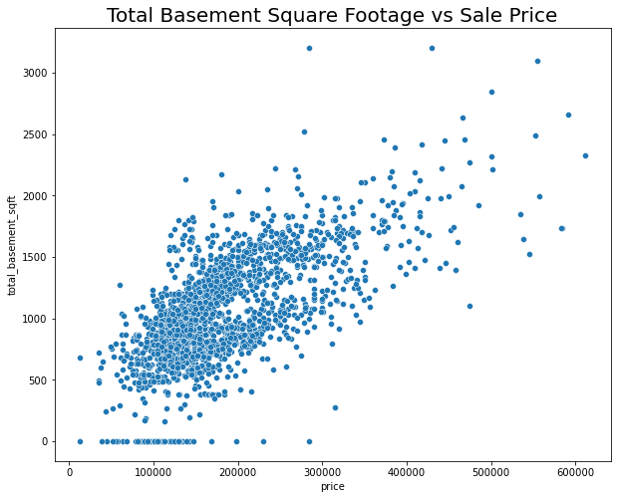
Top Three Correlated Features
All three features demonstrate a linear relationship with the target variable.

Slide 9
Selecting features list
Scaling the data
Fit Linear Regression, Ridge CV , Lasso CV models to the data
Instantiate polynomial features
Train-Test Split for Evaluating Machine Learning Algorithms
Data Modeling

Slide 10
Evaluating the Models
Model | Train Score | Test Score | RMSE
Linear Regression | 0.90 | 0.88 | 26661
RidgeCV Regression | 0.89 | 0.88 | 26156
LassoCV Regression | 0.89 | 0.88 | 26109
Based on RMSE , best fit model is LassoCV.

Slide 11
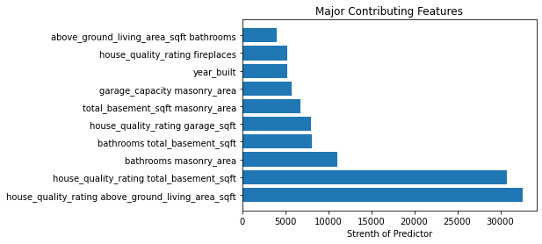
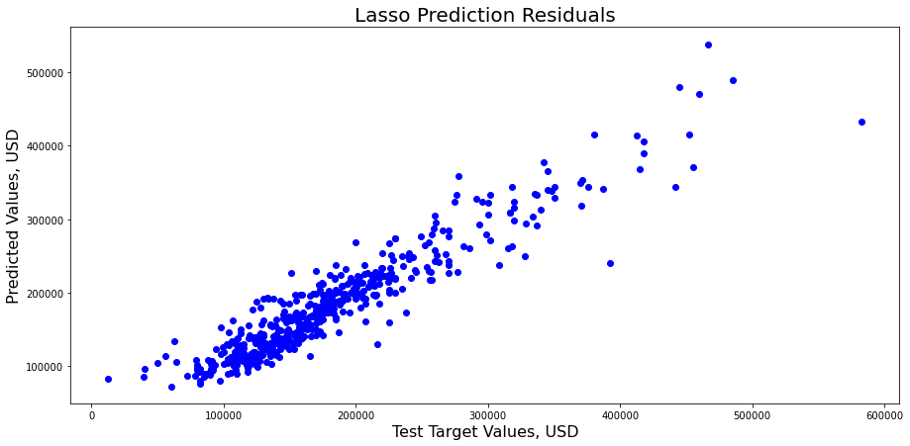
LassoCV Model Results

Slide 12
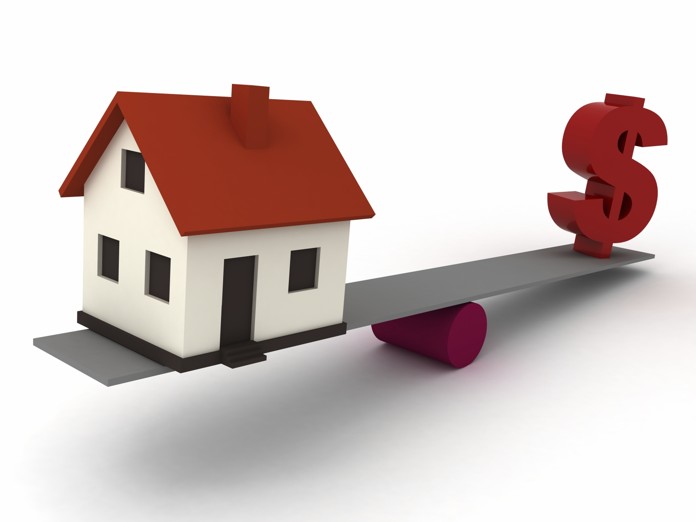
Conclusion
Prediction of sale price
RMSE yields an error of ~±$26109 for average sale priced house($181411)
Factors that affect sale price :
Overall house quality
Living Area Square footage
Basement Square Feet
Garage Square Feet
Garage Car Capacity
Number of Fireplaces
Year Built (The more recent is the house built, the higher is the sale price)
Total number of bathrooms
Area of Exterior Masonry

Slide 13
Thank you

